Slide 1
Housing Data Review

Slide 7
Median Income: $60,465
Mean Income: $81,177

Slide 11
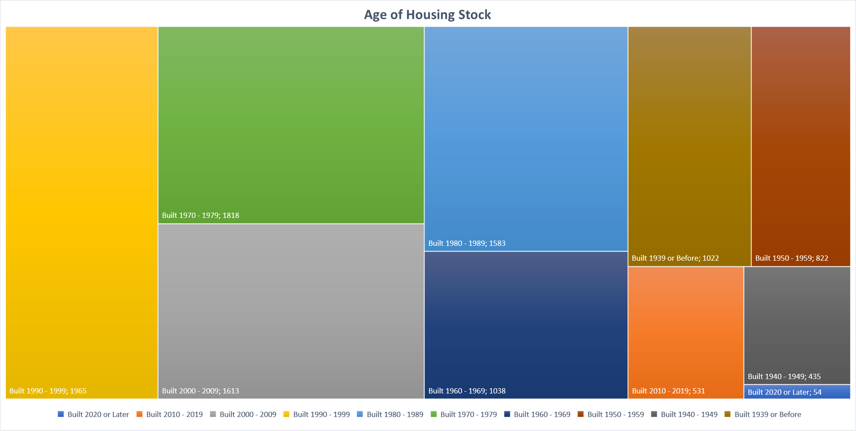

Slide 25
Source: Redfin, a national real estate brokerage. https://www.redfin.com/news/data-center/

Slide 26
Source: Redfin, a national real estate brokerage. https://www.redfin.com/news/data-center/

Slide 27
Source: Redfin, a national real estate brokerage. https://www.redfin.com/news/data-center/

